Slide 1
Sussex County Community College
Accessibility Services

Slide 2
What is a disability?
As defined by the US Department of Justice, person with a disability is someone who:
has a physical or mental impairment that substantially limits one or more major life activities,
has a history or record of such an impairment (such as cancer that is in remission), or
is perceived by others as having such an impairment (such as a person who has scars from a severe burn).
ADA
U.S. Department of Justice Civil Rights Division

Slide 3
Substantially limits and major life activities
The term “substantially limits” is interpreted broadly and is not meant to be a demanding standard. But not every condition will meet this standard.
An example of a condition that is not substantially limiting is a mild allergy to pollen.
Pregnancy, unless medical complications arise
Major life activities are the kind of activities that you do every day, including your body’s own internal processes. There are many major life activities in addition to the examples listed here.
Some examples include:
Actions like eating, sleeping, speaking, and breathing
Movements like walking, standing, lifting, and bending
Cognitive functions like thinking and concentrating
Sensory functions like seeing and hearing
Tasks like working, reading, learning, and communicating
The operation of major bodily functions like circulation, reproduction, and individual organs

Slide 4
Laws Governing Disability Resources
Section 504 of the Rehabilitation Act of 1973
The Americans with Disabilities Act (ADA) -1990
The Americans with Disabilities Act Amendments Act (ADAAA) -2009
October 11, 2016: DOJ amended ADA regulations to align Title II and III of the ADA with Title I of the ADA (employment regulations)
Other federal and state legislation
SCCC https://www.sussex.edu/student-support/student-accessibility-services/student-guide/
SCCC https://sussex.edu/current-students/student-handbook/academic-information-support/

Slide 5
Difference Between High School and College
High School
College
I.D.E.A. Individuals with Disabilities Education Act Section 504, Rehabilitation act of 1973
I.D.E.A. is about SUCCESS
ADA Americans with Disabilities Act of 1990, Section 504Rehabilitation Act of 1973
ADA is about ACCESS

Slide 6
Documentation
High School
College
IEP Individualized Education Plan and/or 504 Plan
Educational and or Psychological Evaluation
School provides the evaluation
Documentation is used to determine if a student is eligible for services based on the 13 disability categories
High IEP, 504Plan, Educational and Psychological Evaluations are used to assist in determining which academic accommodations are applicable at the college level
If student does not have documentation, they can be evaluated at their own expense
Documentation from a licensed medical provider may also be considered

Slide 7
Student Advocacy
High School
College
Parent advocates for student
School arranges testing and accommodations
Teaches reach out if they feel student needs assistance
Student advocated for themselves
Student contacts Accessibility Services office

Slide 8
Course Material
High School
Teachers can modify curriculum, alter assignments, alter pace of instruction
Work may be read during class discussed, clarified and re-taught
Reading may not be required outside of class
Reminders of assignments and deadlines are reiterated
College
Professors are not required to modify curriculum or alter assignments
Reading includes text and supplemental materials outside of class
Student need to complete assigned reading and review material outside of class
Students are expected to refer to syllabus or due dates

Slide 9
Grades and Assessments
High School
IEP/504Plan may include modifications to assessments
Testing usually covers a small amount of material
Makeup tests are available if absent
College
Modifications to assessments
How assessments are given (testing center, extended time) may be provided based on documentation
2 or 3 exam are typically given, more material covered
Professors have a strict make-up policy for missed assessments
Please consult course syllabus

Slide 10
Process
Make an appointment with Accessibility Services
Appointments can be scheduled through a link on the Student Success Center webpage
Provide a copy of your documentation to the Accessibility Services office
During the meeting the accommodations you are entitled to will be reviewed
A Letter of Accommodation will be prepared, it is the students responsibility to provide a cop of the letter to each of their professors each semester. Letters will be emailed to the students SCCC email account.

Slide 11
Common Accommodations
Testing in a distraction reduced environment
Extended time for testing
Assessment questions may be read by a proctor
Copies of lecture note and/or Powerpoints
Extended time for assignment deadlines
ASL Interpreter Services

Slide 12
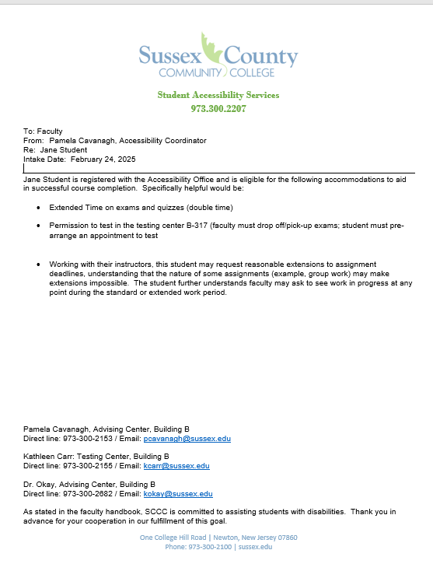

Slide 13
Support Services
Tutoring
Mental Health
Resources
Writing Center
STEM Tutoring - Library
Short term counseling
Lakeside Counseling
U Will
Veteran Counselor
Nutrition Center
Degree UP
DSAI/PSS

Slide 14
Meet with me
Pamela Cavanagh, M.Ed.
Coordinator of Accessibility Services/ADA
B210 – Student Success Center
Building B
pcavanagh@sussex.edu
973-300-2153
www.sussex.edu Student Success Center

